Slide 1
Human Development
Chapter3

Slide 2
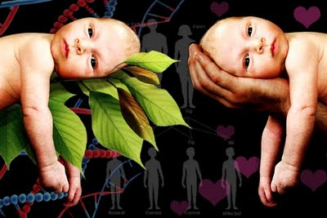
Human Development
Nature
  Heredity
    Genetic transmission
    DNA sequencing
Nurture
  Environment
    Epigenetics
    DNA expression
    Rearing practices
    Psychological and physical trauma
    Chronic life stressors
    Self-Reflect questions (page 89)
      Talk and share with your neighbor
      http://youtu.be/1gwnzW4jOMI

Slide 3
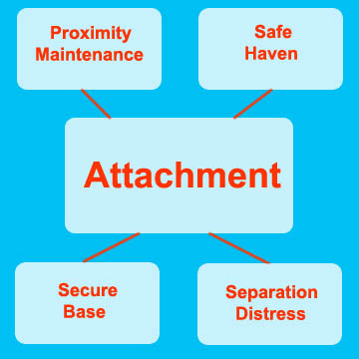
Human Development

Slide 4
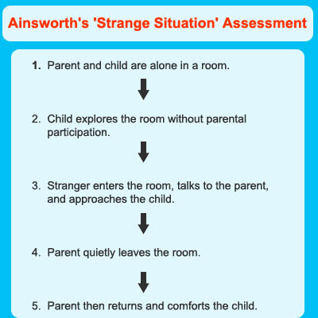
Human Development
http://youtu.be/QTsewNrHUHU

Slide 5
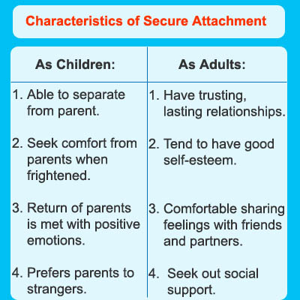
Human Development

Slide 6
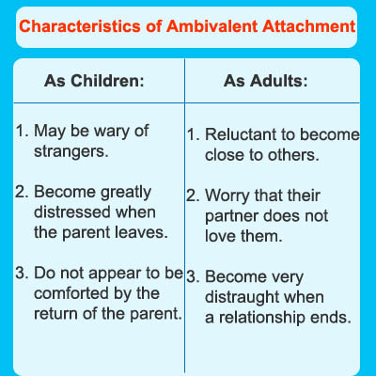
Human Development

Slide 7
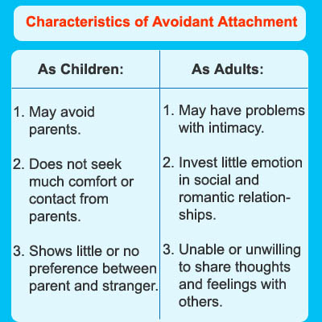
Human Development

Slide 8
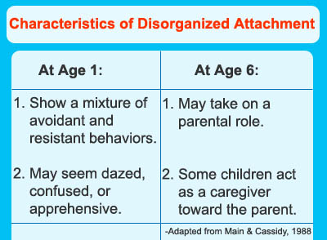
Human Development

Slide 9

Human Development
What’s Your Attachment Style?
  Page 95
  Talk and share in your group

Slide 10
Human Development
Parenting styles http://youtu.be/AGHyB9MsMho
Answer the Self-Reflect questions on page 98 with your group
 | Responsive | Non-Responsive
Demanding | Authoritative | Authoritarian
Non- Demanding | Passive/Indulgent | Neglectful/Uninvolved

